Slide 1
Life Cycles & Phenology
March 30, 2021

Slide 2
Life cycles

Slide 3
Seeds and germination

Slide 4
Not all plants have seeds! What’s the benefit?

Slide 5
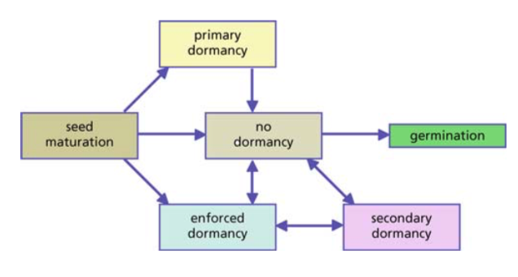
Dormancy - not all seeds germinate immediately

Slide 6
Two primary benefits of dormancy
Avoid poor growth conditions
Avoid competition

Slide 7
Two primary benefits of dormancy
Avoid poor growth conditions
Avoid competition
Knowing this, what would be the important cues to respond to? (Let’s make a list)

Slide 8
Environmental cues

Slide 9
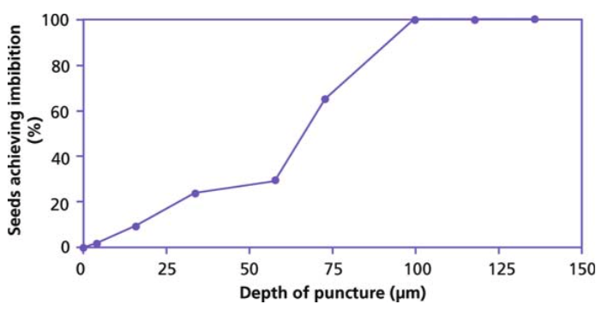
Water – some plants will only imbibe after seed coat is worn down

Slide 10
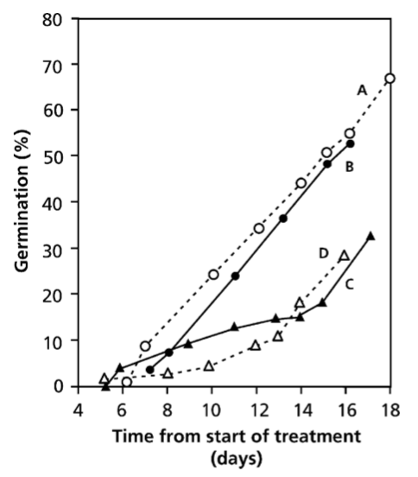
Water soluble inhibitors can also prevent germination during dry times
93 hours of watering
24 hours of watering

Slide 11
Light influences germination in 3 ways
A total light requirement
Intensity and duration
Spectral compositions of light

Slide 12
Light influences germination in 3 ways
A total light requirement
Avoid being buried too deep in the soil (fatal germination)
When soil is turned over, seeds emerge
Intensity and duration
Spectral compositions of light

Slide 13
Light influences germination in 3 ways
A total light requirement
Intensity and duration
Take advantage of disturbance
Spectral compositions of light

Slide 14
Light influences germination in 3 ways
A total light requirement
Intensity and duration
Spectral compositions of light
Plants can sense what is happening above them!

Slide 15
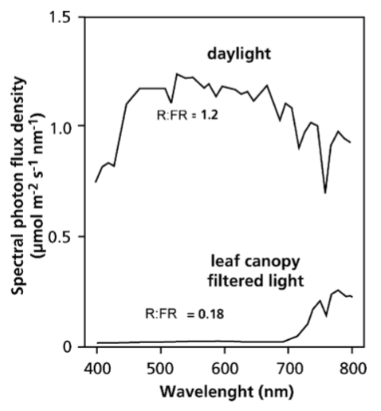
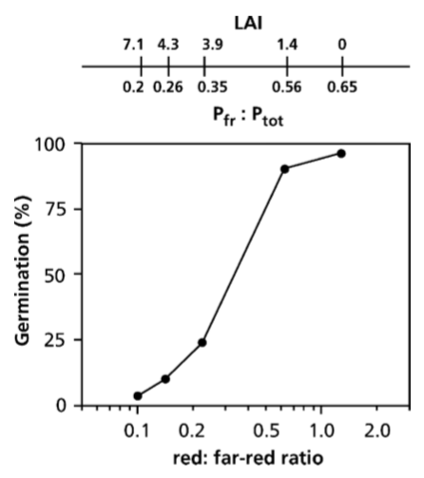

Slide 16
Temperature influences dormancy in two ways
Absolute temperature
Temperature fluctuations

Slide 17
Temperature influences dormancy in two ways
Absolute temperature
Cue to germinate at optimal time in season
Temperature fluctuations

Slide 18
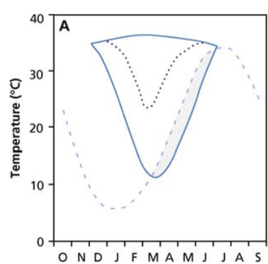
Summer Annual
Maximum T in field
Minimum T for
germination

Slide 19
Temperature influences dormancy in two ways
Absolute temperature
Temperature fluctuations
Mechanism to sense soil depth

Slide 20
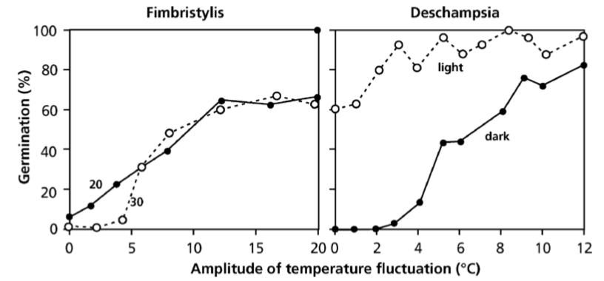

Slide 21
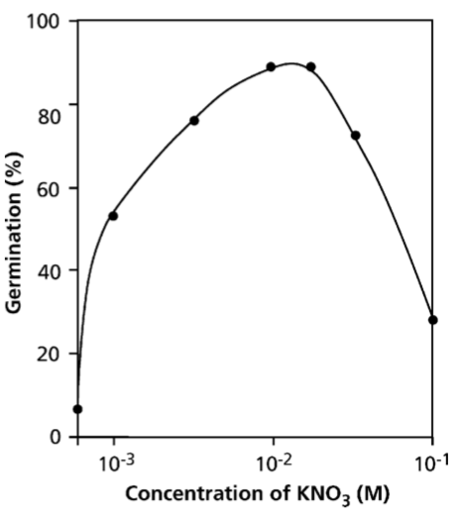
Presence of nitrate can signal competition
More NO₃ = less competition

Slide 22
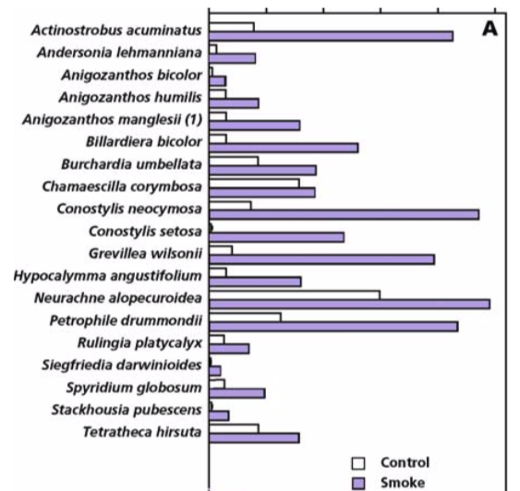
Smoke can also enhance germination

Slide 23
Mechanism for dormancy release

Slide 24
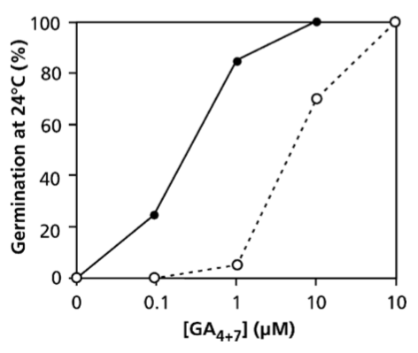
Dormancy release signals: an increase in the ratio of giberrelic acid (GA) to absciscic acid (ABA)

Slide 25
Summary

Slide 26
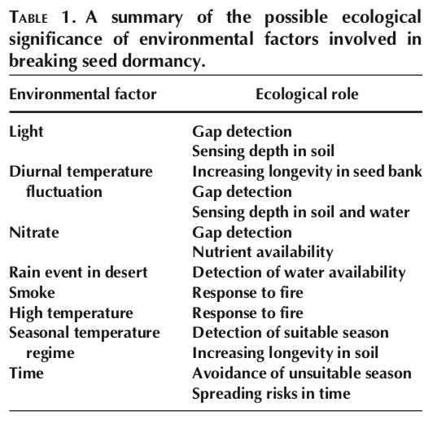

Slide 27
Seedling/juvenile phase

Slide 28
Being a seedling is tough
Low light
Prone to desiccation
Resources determined by seed size

Slide 29
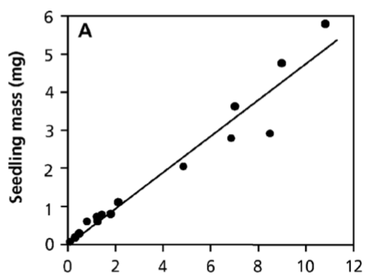
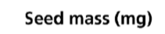
Seed size trade-offs
Bigger seeds = bigger seedlings

Slide 30
Seed size trade-offs
What’s the tradeoff??

Slide 31
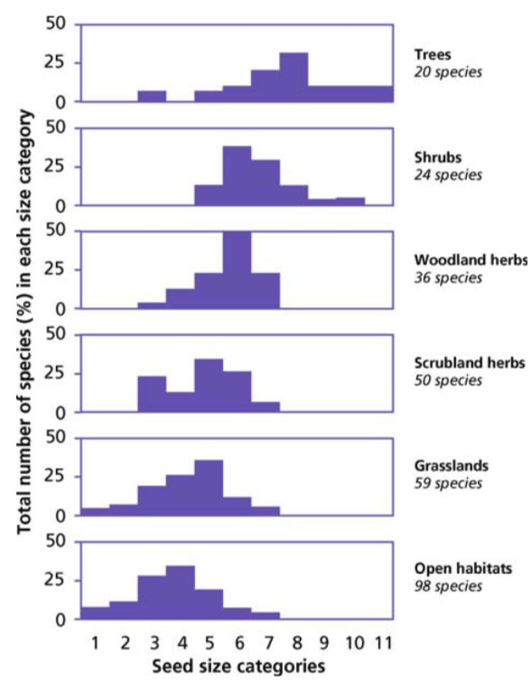

Slide 32
Reproductive phase

Slide 33
Cost of reproduction
Flowering and fruiting: up to 30% of NPP
Median: 10%
In some cases, can require large storage reserves
Trade-off between vegetative and reproductive growth

Slide 34
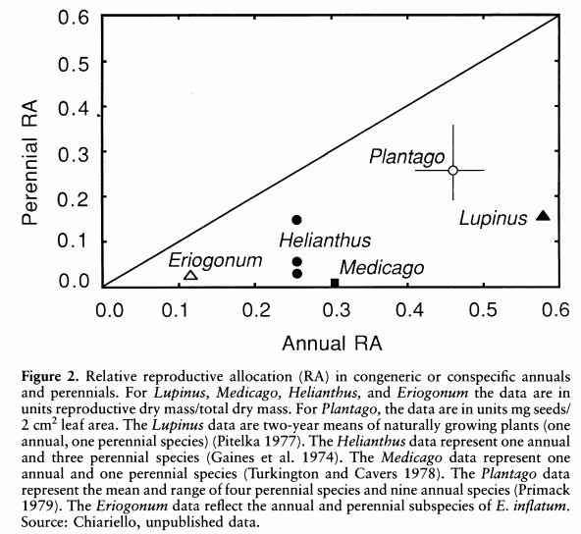
Bazzaz et al. (1987)

Slide 35
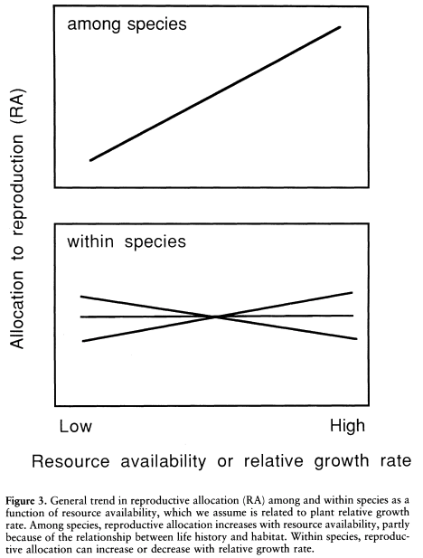
Bazzaz et al. (1987)

Slide 36
Generally the cost of female structures is greater than males structures
Carbon allocation to female flowers can be 3x a male flower (Lambers book)
Nitrogen difference may be even greater

Slide 37
Some plants can reproduce vegetatively
Carbon cost to reproduce sexually can be 10,000-fold greater than asexual reproduction in some places
Why don’t all plants reproduce asexually?
Larrea tridentata

Slide 38
Life cycle diversity

Slide 39
Timing of development
Annuals
Perennials
Bi-ennials
Where would you expect each to dominate?

Slide 40
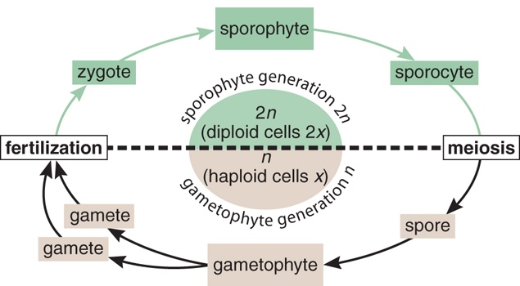
Time spent as a gametophyte
Bryophytes are gametophyte (1n) dominant
What’s the advantage of sporophyte dominance?

Slide 41
Phenology

Slide 42
What are the benefits of being deciduous or evergreen?

Slide 43
What are the costs of being deciduous or evergreen?

Slide 44
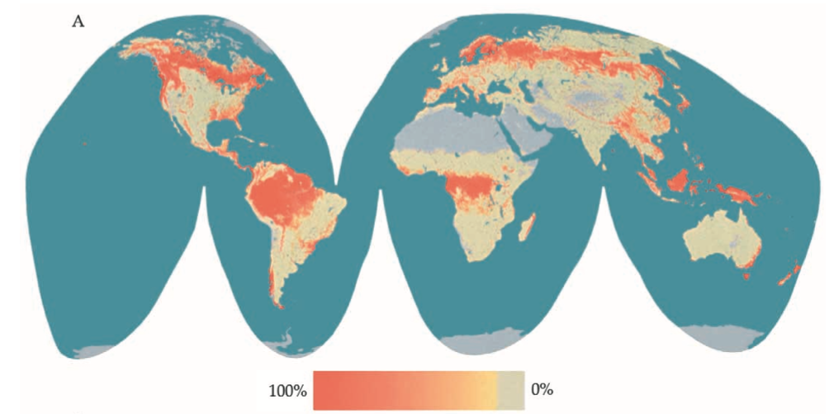
Bimodality of phenological strategies
Many evergreens in high and equatorial latitudes, but not so many in mid latitudes
Evergreenness
Givnish (2002)

Slide 45
Givnish’s paradoxes
Why are boreal forests dominate by evergreens when they are exposed to intense thermal seasonality and winter drought?
Why do deciduous larches often dominate nutrient-poor bogs and swamps in the boreal zone?
Why do evergreen leaf exchanges dominate nutrient-poor sites in the seasonally dry subtropics?

Slide 46
The importance of leaf phenology

Slide 47
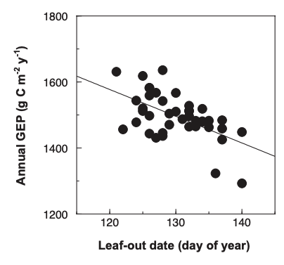
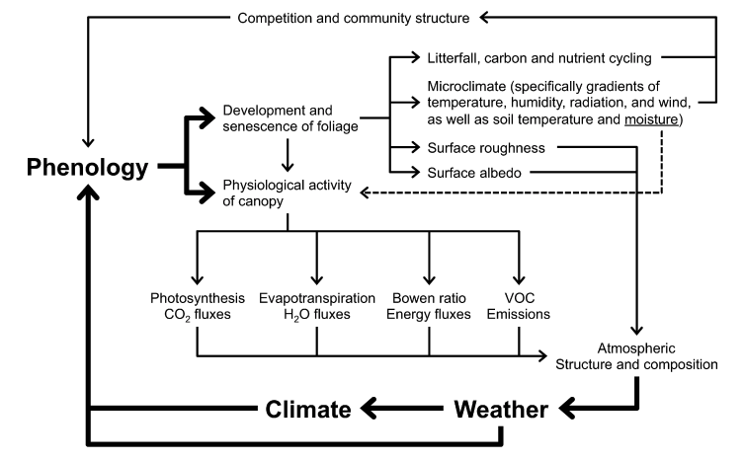
Richardson et al. (2013)

Slide 48
The timing of leaf phenology

Slide 49
In temperate regions, temperature determines Spring leaf out
Keenan et al. (2014)

Slide 50
Water is more important in tropical climates
Xu et al. (2016)

Slide 51
Autumn phenology is much harder to predict…
maybe determined by spring phenology?
Keenan et al. (2015)

